Slide 1
Crypto 101
No, not bitcoin, duh

Slide 2
Aboutme.txt

Slide 3
Todays subjects
History of cryptography
Basics: Symmetric and asymmetric, hashing functions, signing
Current trends: Curves & Post Quantum
Certificate Authorities, Intermediate Certificates and other things that can annoy you
Great ways to let AI help you
Pitfalls and tips

Slide 4
History: Caesar cipher
➡️ 5
➡ V | ➡W | ➡ X | ➡ Y | ➡ Z | A | B | C | D | E | F | G | H | I | J | K | L | M
A | B | C | D | E | F | G | H | I | J | K | L | M | N | O | P | Q | R
A shift of n chars, where n is the secret
Easily done physically by having two scrolls above eachother
Reversible by shifting -n
C(“banana”, 5) ➡ “gfsfsf”
Also sometimes called ROT-n (for ROTation)
Fun in hackerscene culture: ROT-13 and double-ROT-13 (extra safe!)

Slide 5
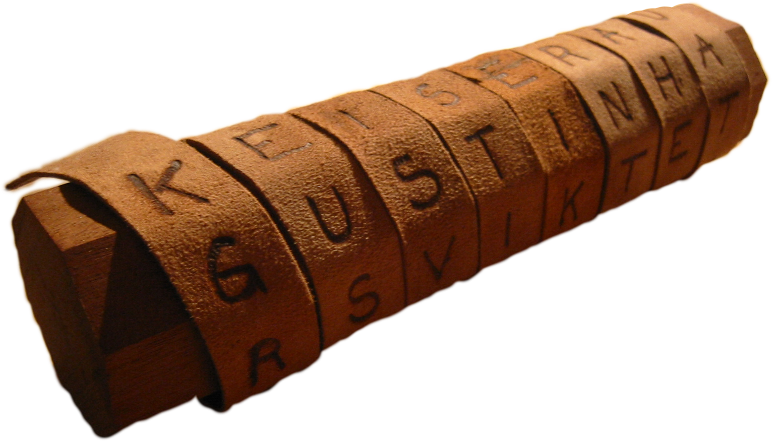
History: Scytale cipher
Wrap a tape or band around a cylinder
Write your text line by line on the tape, one character per tape width
Send only the tape, as the diameter of the cylinder is the secret
While unwrapped, the text is illegible
Only the correct shape cylinder can decrypt the message
Relatively strong at the time!

Slide 6
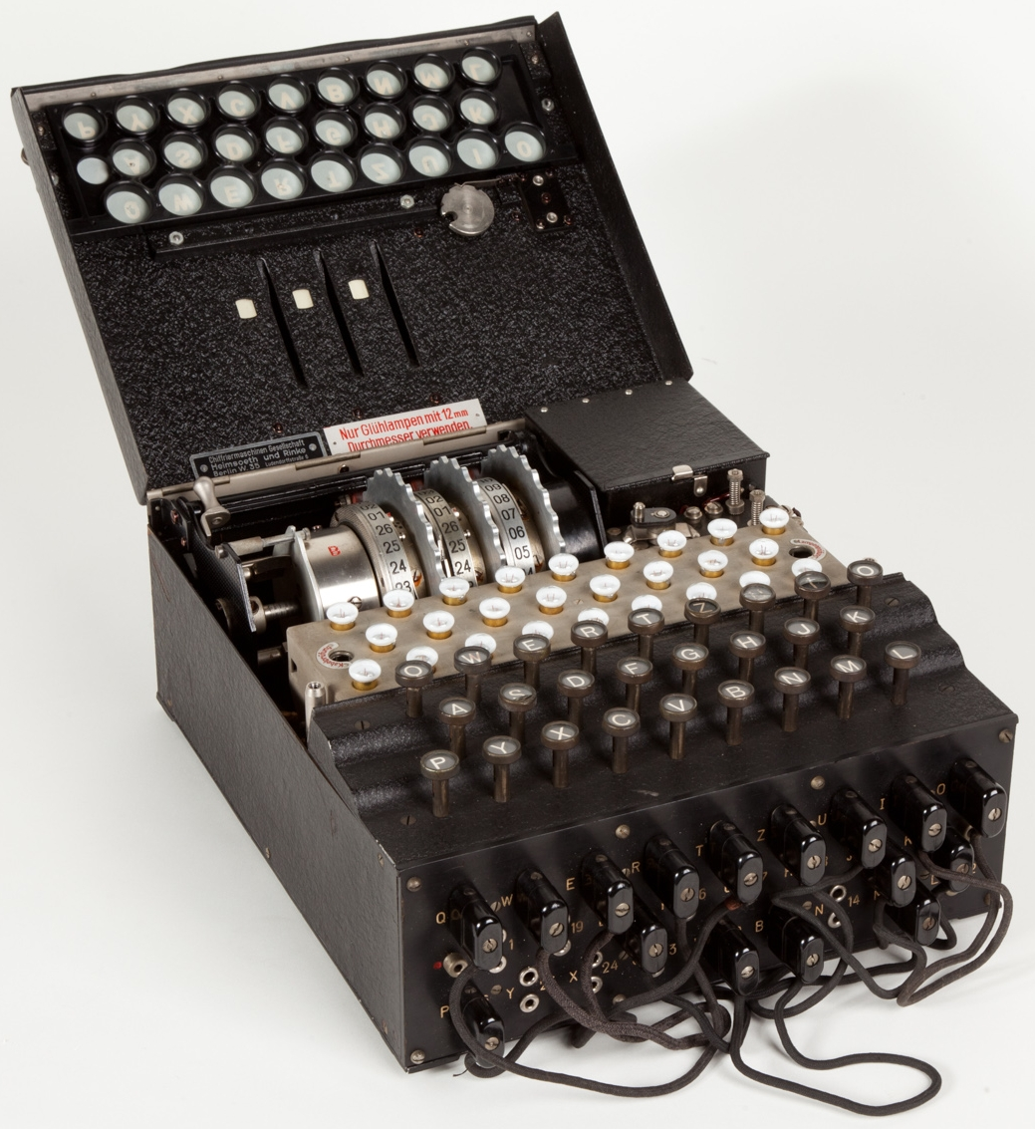
History: Enigma Machine
German post-WW1 invention intended for commercial use
Adopted by German forces in WWII for command & control
Daily changes to start parameters for security (rotor start, rotor order)
Rotors encrypt keypresses and then advance
Symmetric encryption: use the same start parameters for decrypt
Eventually cracked by static analysis and protocol weaknesses
First big public use of permutational analysis (Zygalski sheets)

Slide 7

History: RSA
1976: Diffie-Hellman Key Exchange was published, but no practical applications were provided at the time
1977: three MIT professors – Ron Rivest, Adi Shamir, and Leonard Adleman created the RSA cryptosystem based on the work of Diffie and Hellman
Asymmetric, with a public and private keypair
Idea: factoring prime numbers is computationally hard, but multiplication is easy;
This makes encrypting and decrypting easy, but brute-force cracking hard.
A similar system was developed secretly at GHCQ in 1969

Slide 8
Symmetric encryption
Uses the same method and key for encryption and decryption
So this means that anybody with the key can encrypt, or decrypt
Fast to encrypt large amounts of data, efficient algorithms
Examples:
Data Encryption Standard / DES (1970) (unsafe now!)
3DES (1981) (also unsafe now!)
Advanced Encryption Standard (Rijndael) / AES (1998)
Blowfish

Slide 9

Symmetric encryption
Demo!
aa3YKL5EEB5XQbH5Pqp3dA==
GdAqNssEfdOjzbkZmYhSBQ==
XDxcGdUqcLAL2Pqx7Dl7pQ==

Slide 10
Symmetric encryption - AES
Don’t invent, use a framework and/or library (cpu acceleration!)
Take randomization seriously – use secure key tools like RandomNumberGenerator (in .Net)
Take key storage seriously – where possible in an HSM or Keyvault
The IV randomness is extremely important for long-term safety
Common Mistake: Reusing the same IV for multiple encryption operations, which can lead to patterns in the ciphertext and potential vulnerabilities.
Store the IV alongside the crypto payload – it’s not a secret, don’t confuse others by handling as such

Slide 11
Hashing
One-way function with data loss
Many reasons to do this
Data integrity and validation
Secret storing and testing (passwords)
Digital signatures
Efficient data retrieval (hash tables)
Blockchain
Deduplicating and fingerprinting
Deterministic randomness
Biometric data
Optimized for speed, usually

Slide 12
Hashing - risks
In passwords: collisions & rainbow tables
MD5
Collision attacks
Cryptographic analysis / predictability, rainbow tables
Pre-image attack
Length Extension attack
Timing attacks
Static salting, salting mismanagement

Slide 13
Demo: passwords in SHA-512

Slide 14
Hashing –HMAC signature
Hash-based message authentication code
Useful when you don’t have a clear protocol but still need to validate authenticity of both message and sender
Pre-shared key, so method of safe key exchange is essential
Usually part of a bigger scheme like webhooks example
Basic rules still apply!
Randomness
Key safety
Key rotation
Don’t invent, use your framework

Slide 15
Demo: HMAC based message signing

Slide 16
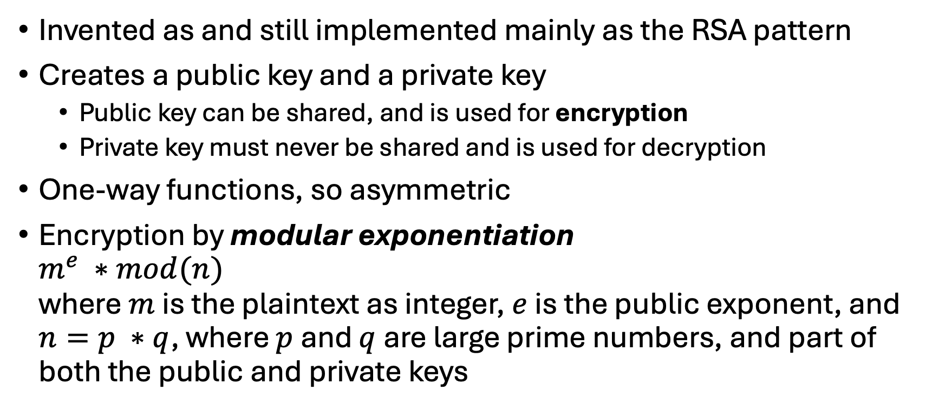
Asymmetric encryption
Invented as and still implemented mainly as the RSA pattern
Creates a public key and a private key
Public key can be shared, and is used for encryption
Private key must never be shared and is used for decryption
One-way functions, so asymmetric
Encryption by modular exponentiation $m^{e} ∗mod(n)$ where $m$ is the plaintext as integer, $e$ is the public exponent, and $n=p ∗q$, where $p$ and $q$ are large prime numbers, and part of both the public and private keys

Slide 17
Demo: encryption and decryption with RSA

Slide 18
Asymmetric encryption: Signing & validation
We learned we can use the public key to encrypt something
If we however stick the private key in that encryption function, we get a signature value for the plaintext
We can then use the public key to validate this signature value
If the signature matches, we know two things:
The message was created by the authentic source
The message was not tampered with since signing
This is useful!

Slide 19
Demo: Signing with RSA

Slide 20
TLS
Asymmetric encryption is impractical for large data exchange
So how do we do secure data exchange?
Use Asymmetric encryption for validation + key exchange
Use symmetric encryption like AES for the actual data
But what key?
We, as a client, generate a random number, and share it in plaintext with the server (CLIENT HELLO)
The server sends its SERVER HELLO message, including another random number (in plaintext!) and it’s certificate
The client generates a random key, encrypts it with the server certificates public key, and sends the encrypted payload back to the server
Both now have the same two random values and the key, and can use a common method to generate a symmetric key (e.g. 3DES or AES)

Slide 21
TLS 1.3 – Perfect Forward Secrecy
In the previous example (RSA key exchange), the session encryption is based on two publicly transmitted values and the security of the server private key
If someone (most likely government) would record all server traffic, and then subpoena the server contents to get the private key, they could decrypt all recorded traffic
This is considered a bad thing!
The solution was already created back in 1976
Diffie-Hellman Key Exchange or DHKE

Slide 22
TLS 1.3 – Perfect Forward Secrecy with DHKE
The server and client agree on (usually predefined) parameters
A large prime P
A ‘base’ number g
Both the server and client choose a random private key and compute a public key from it
They then exchange the public key with eachother over cleartext
By combining each others public key with their own private key, they arrive at the same shared secret
We use this shared secret as the session key for AES
When the session is done, we both forget all keys involved, as we can simply create a new key when we want to.

Slide 23
Demo: DHKE

Slide 24
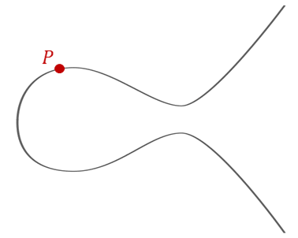
Elliptic curves
Instead of using ’clock arithmetic’ we can use curves
Much smaller integers and keysizes but stronger encryption
Moves on a given (specified) curve
Private key is a scalar
Public key is a point
E.g. Curve25519

Slide 25
Post-quantum
Quantum computers can do strange things
Shor’s Algorithm can effectively (and proven) factor numbers
Not a threat right now, but big advances are being made
… thanks to AI!
ECC has shorter keylengths and needs much less qubits for cracking than (large-keyed) RSA ☹
Many algorithms are being published that should provide safety
KYBER, Supersingular Isogeny Diffie-Hellman (SIDH) & SIKE
Hard to prove, but may be required based on your usecase (govt, mil, non-proliferation): talk to your customer.

Slide 26

Is everybody still awake?

Slide 27
Businessland: Certificates
...
"subject": {
"commonName": "example.com",
"organization": "ExampleCorp",
"organizationalUnit": "IT Department",
"locality": "San Francisco",
"stateOrProvince": "California",
"country": "US"
}
...
How do you get a certificate, and what is it really?
Certificate Signing Request (CSR)
Public key
Private key
Certificate Metadata
Signature

Slide 28


Businessland: Certificates
How do you get a certificate, and what is it really?
CA
Certificate Signing Request (CSR)
2. Sign
X509 Certificate
Public key
Original Public key
Certificate Metadata
Certificate Metadata
1. verify
Signature
3. Generate
CA Signature

Slide 29
Certificate important points
When done well, the private key never leaves your server
Even better: Private key generation in a physical device (HSM)
Because people get this dance mixed up, most services will generate the private key for you as well
This is scary, as they can decrypt everything, and requires trust!
For personal use: USB tokens, Yubikeys

Slide 30
On intermediate certificates
CA business is booming, so sometimes they ‘delegate business’
This means the CA vouches for some other company, and to make this ‘vouch’ verifiable, the ‘top CA’ signs the certificate of the ‘lesser’ CA
Your client doesn’t know about this ’lesser’ CA
You will have to feed the client the entire certificate chain to help it figure out the chain of trust
Thankfully, this usually just means sticking the literal chain of certificates into one file

Slide 31
From an engineer to engineers 1/3
Certificates are both configuration & secret. Treat them as such.
Don’t stick em in git
Use your OS’s keystore, not your filesystem, because you will screw it up
Point to certificates using a configuration parameter (name, thumbprint)
Certificates are easily scanned, stolen and abused. <3 mins on Github
Git doesn’t forget! So if you push a private key, you’ll have to rotate
Don’t stick them in git
Don’t stick them in git

Slide 32
From an engineer to engineers 2/3
Learn to rotate your certificates, and understand your CA processes so you know what to do
You can keep the same private key to generate a new CSR. No need to swap private keys unless you want/need to (policy)
Mark your calendar, and use tooling
For instance, Azure Keyvault can auto alert you when a cert is about to expire
Use tooling like Keyvault to safely store the certificates including the private key to control the entire access and lifecycle of certs

Slide 33
From an engineer to engineers 3/3
Webbased applications that use cryptography have two masters to serve: performance and security
Faster response <> more crypto iterations (CPU heavy)
Time-based attacks
Do not stick your keys in git!
Ask yourself: How do we actually manage keys in a safe manner in our project?

Slide 34
On AI
A lot of the demos in this talk were built with AI support
AI will help attackers more quickly assess your application
If you don’t use it for defense, others will use it for offense
Trust, but verify: be responsible with applying AI generated code

Slide 35

Fin
Any questions?
https://github.com/tobiasoort/ictdevday24

